Slide 1
Refactoring

Slide 2
Refactoring Improving the Design of Existing Code
读后感
杨奇 2015/10

Slide 3
Any fool can write code that a computer can understand. Good programmers write code that humans can understand.

Slide 4
What Is Refactoring P46
Refactoring (noun): a change made to the internal structure of software to make it easier to understand and cheaper to modify without changing its observable behavior.

Slide 5
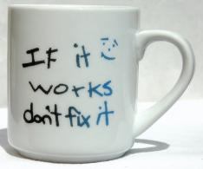
重构是有风险的
If it works, don't fix it.

Slide 6
为何不愿意进行重构
不知道如何重构
老板付钱，希望开发新功能，开发者自己也喜欢做新东西
短期内看不到收益，不被项目经理/老板接受
长期收益，重构者自己都未必看得到
重构可能会引入错误，破坏现有程序
……

Slide 7
Why Should You Refactor? P47
Refactoring Improves the Design of Software
Refactoring Makes Software Easier to Understand
Refactoring Helps You Find Bugs
Refactoring Helps You Program Faster
以重构的方式改进软件质量

Slide 8
When Should You Refactor? P49
The Rule of Three
Here's a guideline Don Roberts gave me: The first time you do something, you just do it. The second time you do something similar, you wince at the duplication, but you do the duplicate thing anyway. The third time you do something similar, you refactor.
Tip Three strikes and you refactor.

Slide 9
When Should You Refactor?
Refactor When You Add Function
Refactor When You Need to Fix a Bug
Refactor As You Do a Code Review

Slide 10
What Do I Tell My Manager? P52

Slide 11
What Do I Tell My Manager?
Don't tell!

Slide 12
What Do I Tell My Manager?
Of course, many people say they are driven by quality but are more driven by schedule. In these cases I give my more controversial advice: Don't tell!

Slide 13
重构必须要有好的测试来保障 P18
Before you start refactoring, check that you have a solid suite of tests. These tests must be self-checking.

Slide 14
具体的重构方法

Slide 15
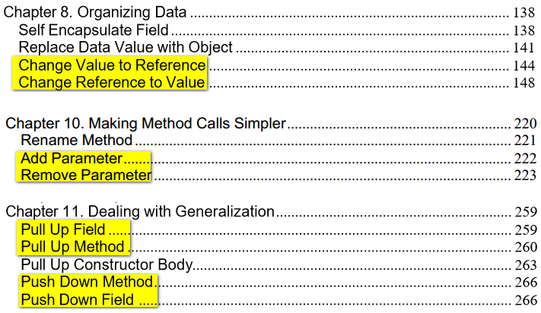
具体的重构方法

Slide 16
Duplicated Code P63
If you see the same code structure in more than one place, you can be sure that your program will be better if you find a way to unify them.
同一个类的两个函数
两个互为兄弟的子类
互不相关的类

Slide 17
Long Method P64
Prefer small and focused functions
https://google-styleguide.googlecode.com/svn/trunk/cppguide.html#Write_Short_Functions

Slide 18
Comments P71
When you feel the need to write a comment, first try to refactor the code so that any comment becomes superfluous.

Slide 19
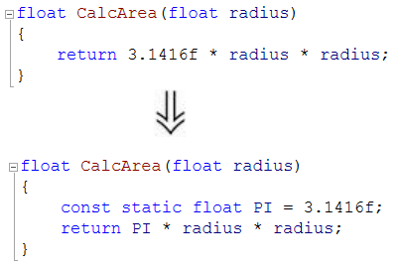
Replace Magic Number with Symbolic Constant P166

Slide 20
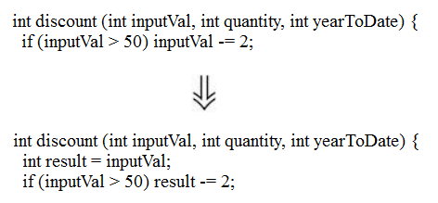
Remove Assignments to Parameters P107

Slide 21
Change Value to Reference P144
Use of const
https://google-styleguide.googlecode.com/svn/trunk/cppguide.html#Use_of_const

Slide 22
Simplifying Conditional Expressions P192
Decompose Conditional
Consolidate Conditional Expression
Consolidate Duplicate Conditional Fragments
Introduce Assertion

Slide 23
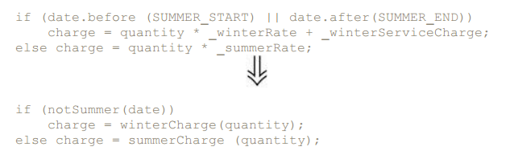
Decompose Conditional

Slide 24
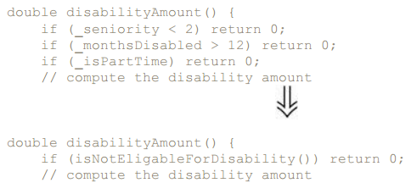
Consolidate Conditional Expression

Slide 25
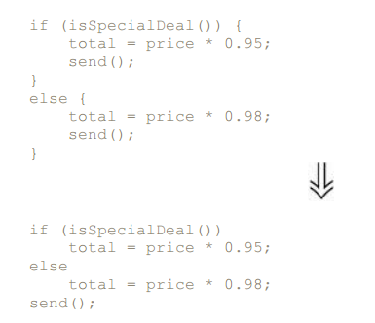
Consolidate Duplicate Conditional Fragments

Slide 26
Introduce Assertion

Slide 27
重构-改善既有代码的设计
链接: http://pan.baidu.com/s/1dDDcnwX
密码: t636

Slide 28
The end

